Slide 1
TACD founded 1998. Steering Committee is CFA, USPIRG, Consumers Union and Public Citizen. Has some funding from EC, recognized by both governments as advisory organization. TACD has advocated stronger protections in health, food, safety, financial, intellectual property and other consumer matters in treaties and agreements between the governments.

Slide 2
Consumers and markets are best served when federal or international rules serve as floors of protection, and member states (EU) or states (US) are allowed to respond with stronger standards responding to emerging or local threats.
Unless we fight back, harmonization, preemption, or regulatory convergence will all result in decrease in consumer and worker welfare.

Slide 3
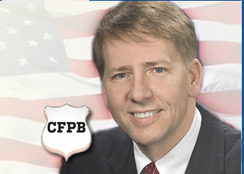
We cannot rely on the Congress:
Congress rarely protects unless a crisis first occurs….some examples:
Dodd-Frank/CFPB reforms—First, queue an historic financial collapse.
Corporate reform—First, roll out the spectacular Enron/Worldcom bankruptcies.
Consumer Product Safety reform —First, send boats full of millions of lead-laden Chinese toys intended for children
Food safety modernization —After publication of the 1906 “The Jungle,” Congress finally did act, 105 years later, in 2011.

Slide 4
Congress may act only after the States (or cities) lead:
Consumers and workers are better off if states can lead the way:
Community right to know act/Toxic Use Reduction Act—worker committees first/then, cities and states/finally Congress.
Free credit reports and other privacy and identity theft reforms—states, states and more states. Last, Congress.
Outdoor air pollution laws, Smoke-free indoor air laws, do-not-call lists, predatory lending reforms (although first long preempted by feds), organic food labeling, etc—all finally passed Congress only after numerous cities and states led the way.

Slide 5
This fight is nothing new to the US Chamber of Commerce and NAM.
They’ve always had greater power in DC than the states, which are closer to the voters.
Now, they see international treaties as an ever better way to limit public protections than federal preemption.
International harmonization is a way to eliminate sensible safeguards and public protections once and for all.

Slide 6
But, in many areas, our best chance to increase US protections is to
Continue to work with European allies and
Continue to insist that trade policies preserve stronger local laws.

Slide 7
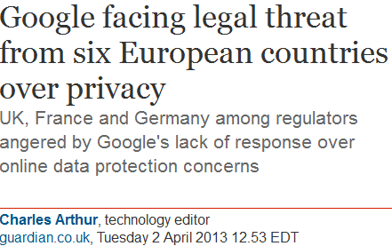
Examples include:
Privacy—President Obama has proposed a strong privacy bill of rights, but best US chance is through defending the even stronger Euro laws and strengthening proposals.

Slide 8
Protecting the US from chemical hazards:
REACH remains the best template to strengthen weak US protections (Toxic Substances Control Act) because European regulators rely on the Precautionary Principle, which is supported by US Health and safety groups but opposed by US industry.
“A More Precautionary Policy: EU’s REACH
The U.S. approach to chemicals policy has fallen behind global changes, led by the European Union (EU). Most important among the
EU’s new legislation is the 2006 regulation on the Registration, Evaluation, Authorization, and Restriction of Chemicals (REACH).”
- Center on Occupation Safety and Health, University of California

Slide 9
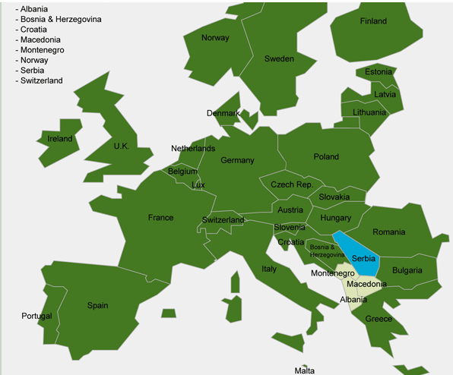
Genetically Modified Food Labeling: Despite defeat of Prop. 37 on California ballot (2012), voters in CA support labeling.
“The results of our poll show that voters continue to strongly support the concept of labeling,” said Robert G. Meadow, Ph.D., a partner at Lake Research Partners. “The campaign simply was outspent.”
-- Poll for TACD member Center for Food Safety.
Below: Green means GMO labeling; blue GMO import ban.

Slide 10
TACD Letter to Ambassadors Kirk and Commissioner De Gucht (March 2013):
…an agreement aiming for regulatory convergence will only be acceptable if it requires high standards of consumer and other protections and related compliance, while affording both trading partners the autonomy to adopt stronger facially non-discriminatory protections. ...
Ed Mierzwinski, edm@pirg.org, 202-461-3821
U.S. PIRG Consumer Program Director
U.S. Co-Chair, TACD Steering Committee

